Slide 1
Bioinformatics
1
UNIVERSITY OF BASRAH / COLLEGE OF SCIENCE
1 Biological Databases
2
Primary Databases
3
Prof.Dr. Saad S. Mahdi Al-Amara
Secondary Databases
LECTURE PhD. 2

Slide 2
Biological Databases
2
Databases :
Is a computerized archive used to store and organize data in such a way that information can be retrieved easily via a variety of search criteria.
Also
Are composed of computer hardware and software for data management. The chiefobjective of the development of a database is to organize data in a set of structuredrecords to enable easy retrieval of information.
Biological databases
Are libraries of life sciences information, collected from scientific experiments, published literature, high-throughput experiment technology, and computational analysis.

Slide 3
Biological Databases
3
TYPES OF DATABASES :
1.Primary Databases:
There are three major public sequence databases that store raw nucleic acid sequence data produced and submitted by researchers worldwide: GenBank, the European Molecular Biology Laboratory (EMBL) database and the DNA Data Bank of Japan(DDBJ), which are all freely available on the Internet.

Slide 4
Biological Databases
4
TYPES OF DATABASES :
2.Secondary Databases:
Sequence annotation information in the primary database is often minimal. To turn the raw sequence information into more sophisticated biological knowledge,much postprocessing of the sequence information is needed.

Slide 5
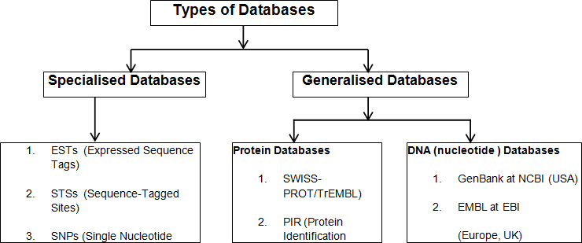
Biological Databases
5

Slide 6
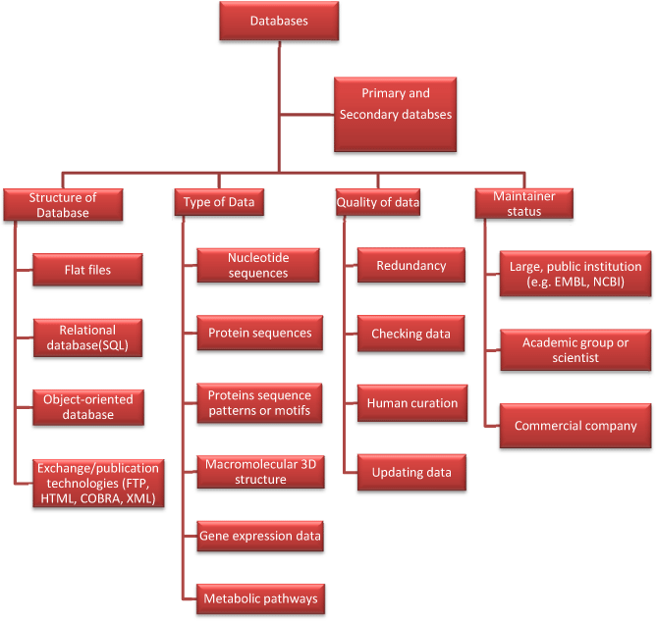
6

